Slide 1

PERSONAL DATA
Written by Luu Quoc Thang
Apply for Embedded Software Development Engineer Position

Slide 2

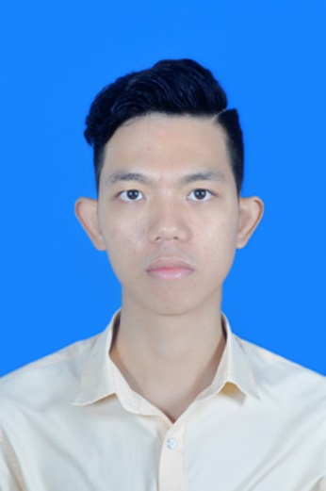
1. Persional Information
Fullname: Trần Ngọc Thắng
Gender: Male
Date of birth: 01/04/1993
Place of birth: ThaiBinh, Vietnam
Contact details:
Phone number: +841663484477
Email: ngocthang1493@gmail.com
Character: Friendly, careful, hardworking, humor
2

Slide 3
2. Education
University:
From August 2011 to June 2016: Student of Posts and Telecommunications Institute of Technology(PTIT)
Major: Information Technology- Software Technology
GPA (current): 7.1/10
Certificate: TOEIC 550, Examination at FPT Software
3

Slide 4
3. Personal Skills
Skills:
Deverloper skills: C++ - PyThon Testing skills: Automation Test - Requirements Analysis/TR Tool: - Visual Studio QTCreator Pycharm Cmake Others: - Machine learning | Advance Basic Basic Basic Advance Basic Basic Basic
5

Slide 5
4. Working Experience
No | Metrics | Results
1 | Experience (Years) | 2 years
2 | Experience ( Project) | 3 projects
3 | Experience ( Team lead) | N/A
4 | Domain | Embedded Desktop application Machine learning
5 | Performance | - All project meet target that request from customer
4

Slide 6
5. Projects (1)
2/2017-6/2017
Project name: SWT(FPT’s Project in cooperation with LGE)
SWT work on the CMA models(LG is developing the Geely with 2 models:CMA and MIB)
Position: Developer and Tester
Programming language: C++
Tools/Hardware: QT Creator, Shell, Source insight
Task: Support Automation test and environment all member
6

Slide 7
5. Projects (2)
7/2016-2/2017
Project name: IIG9 (FPT’s Project in cooperation with NTT)
3D model visualization and 3D point group Software
Position: Developer
Programming language: C++
Tools/Hardware: Visual Studio 2013, Cmake, Cloudcompare
Task: Processing image big data, development according to customer design
7

Slide 8
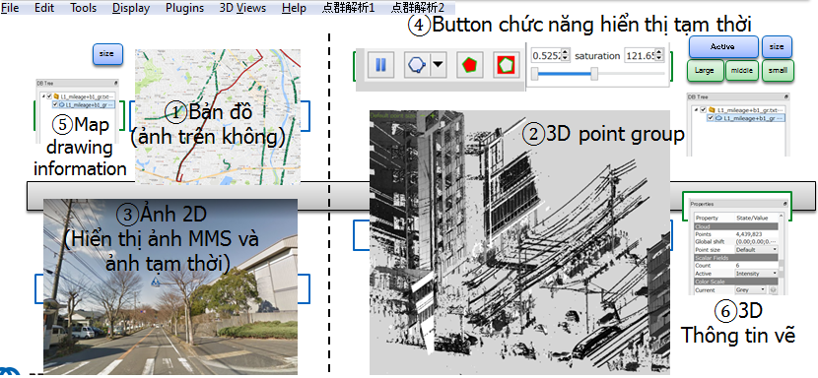
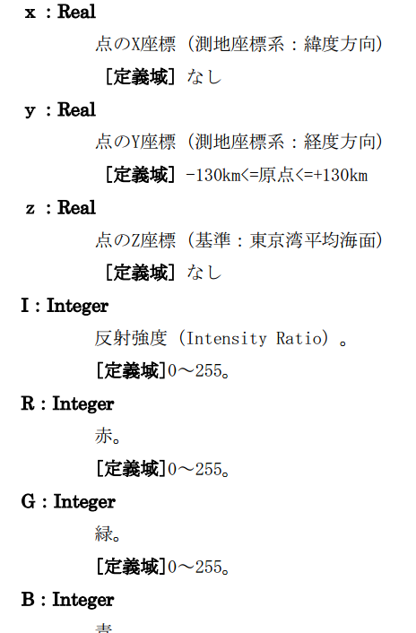
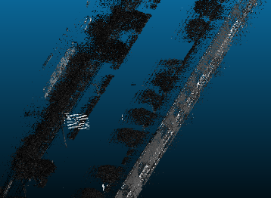
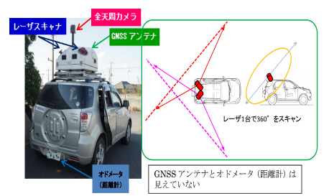
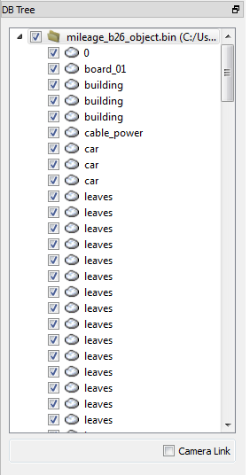
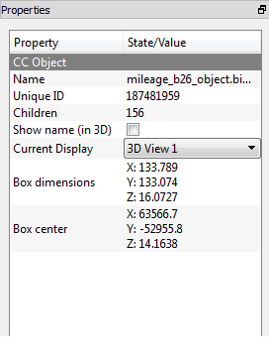
5. Projects (2)
7

Slide 9
5. Projects (3)
1/2016-7/2016
Project name: FVV4 (FPT’s Project in cooperation with Hitachi)
Image media project
Position: Developer
Programming language: C++,Python
Tools/Hardware: Visual Studio 2013, Pycharm, OpenCV, Camera recognize
Task: From video shot with a camera, estimate the 3D posture and display on the screen.
Using AI generates learning data then estimates the maturity of movement
7

Slide 10
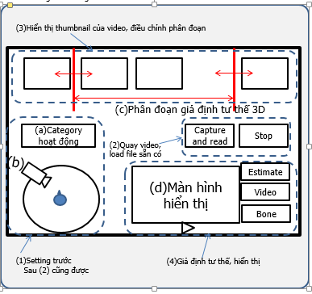
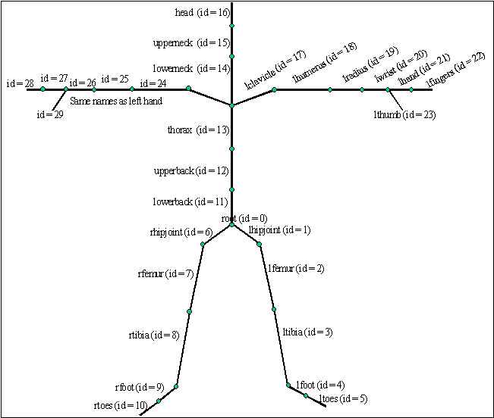
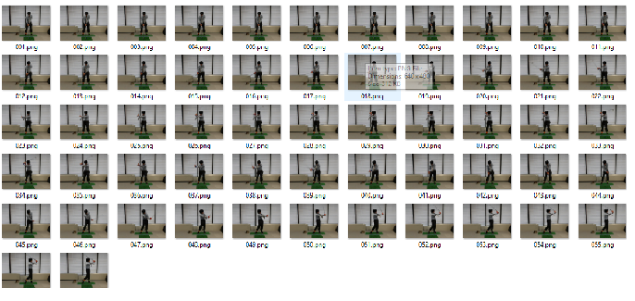
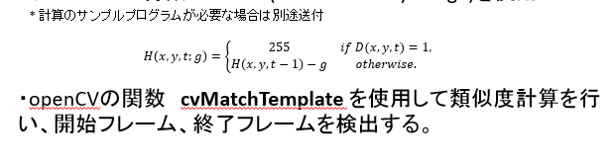
5. Projects (3)
7

Slide 11
6. Future Plans
Knowledge:
Learn more about linux embedded software, Qt framework, linux core
Learn more about AI and Python
Study English
Rank:
Become excellent software engineer
Become software solutions architect or project manager within 3 years
8

